Slide 1
Exploring In silico Pharmacological actions of pramax against sars-cov-2
3D vision school (2025 winter)
Kim Junseok (01916213)
Notes:
My name is Junseok Kim, a BA3 student. My project is ‘Exploring In silico Pharmacological actions of pramax against sars-cov-2’.

Slide 2
content
Predict the possibility of pharmacological effects of Pyramax against SARS-CoV-2
with computational method (in silico)
Based on Drug Discovery process
2/29
Notes:
The goal of this project is to predict the possibility of pharmacological effects of Pyramax against SARS-CoV-2 with computational method. And this is based on Drug Discovery process.

Slide 3
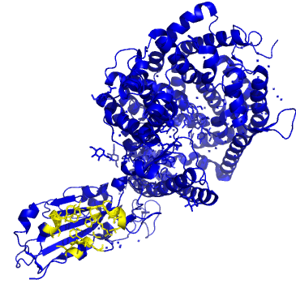
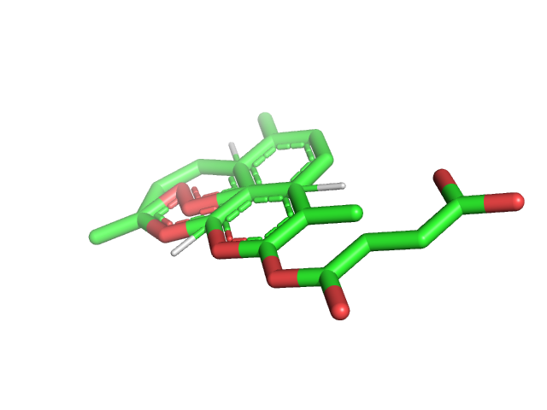
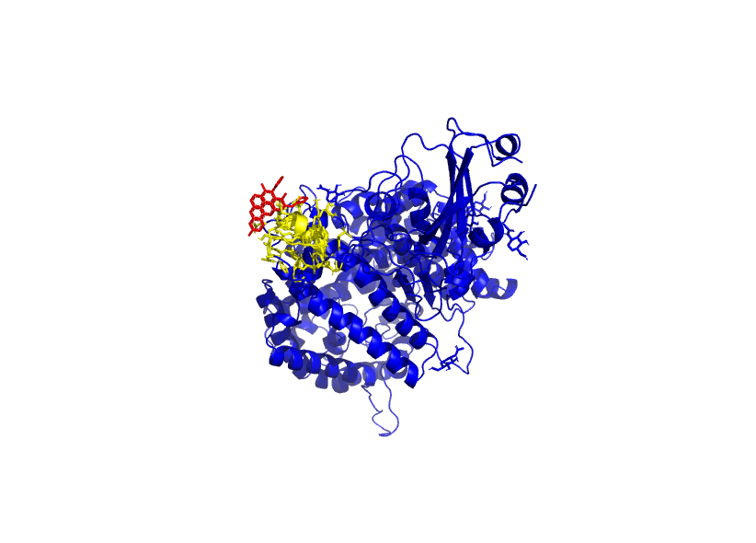
What is drug discovery?
Enzymes = groups of drug target
Ligand-enzyme interaction = major drug discovery process
With computational method:
1) Identification of protein functions,
2) Off-target binding
3) ligand 3D modeling & induced-fit simulations
Enzyme binding site
PDB Ligand
Analysis
Drug discovery
Notes:
Before we talk about the whole project, we should know what drug discovery is.
There are enzymes or proteins which are groups of drug target.

Slide 4
What is drug discovery?
Enzymes = groups of drug target
Ligand-enzyme interaction = major drug discovery process
With computational method:
1) Identification of protein functions,
2) Off-target binding
3) ligand 3D modeling & induced-fit simulations
Enzyme binding site
PDB Ligand
Analysis
Drug discovery
Notes:
And There are ligands or drug substances.
Researching ligand-enzyme interaction is the major drug discovery process.

Slide 5
What is drug discovery?
Enzymes = groups of drug target
Ligand-enzyme interaction = major drug discovery process
With computational method:
1) Identification of protein functions,
2) Off-target binding (drug side effects)
3) Ligand 3D modeling & induced-fit simulations
Enzyme binding site
PDB Ligand
Analysis
Drug discovery
3/29
Notes:
With several computational method,
It is possible to identify protein functions, prevent off-target binding to reduce drug side effects, and lastly conduct docking simulations.

Slide 6
What is drug discovery?
Enzymes = groups of drug target
Ligand-enzyme interaction = major drug discovery process
With computational method:
1) Identification of protein functions,
2) Off-target binding (drug side effects)
3) Ligand 3D modeling & induced-fit simulations
Enzyme binding site
PDB Ligand
Analysis
Drug discovery
3/29
Notes:
In this project, we will focus on the last one, docking simulation.

Slide 7
Introduction
Target Protein: 6M0J (from SARS-CoV-2)
Target Ligand: Pyramax (anti-malarial drug)
Methodology
With Computational method
In vivo / in vitro / in silico
“in silico”: simulations conducted on a computer, not in a laboratory environment or within a living organism.
Notes:
So, I set the target protein as 6M0J from SARS-CoV-2 I set the target drug as Pyramax which is an anti-malarial drug.

Slide 8
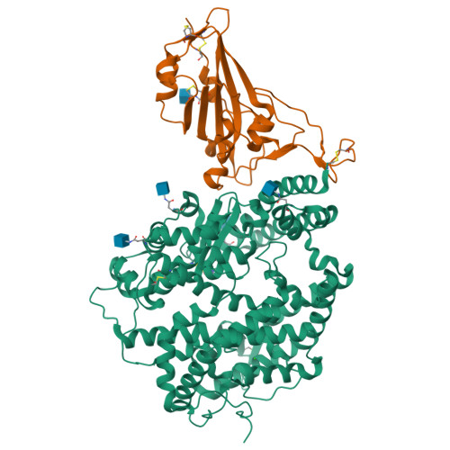
Intro_SARs-CoV-2
SARS-CoV-2:
Since late 2019, it has caused a global pandemic. 1) high transmissibility 2) rapid mutation capabilities
researchers focus on vaccine development, and therapeutic research
6M0J : Crystal structure of SARS-CoV-2 spike receptor-binding domain bound with ACE2 1) the human angiotensin-converting enzyme 2 (ACE2) 2) viral spike protein S1
→ provides crucial insights into the virus's mechanism for entering host cells
Spike protein S1
ACE2
Notes:
Since late 2019, Covid has caused a global pandemic. Its high transmissibility and rapid mutation capabilities have led many researchers to focus on vaccine development, and therapeutic research. 6M0J is as a key enzyme in the replication and transmission of SARS-CoV-2. This enzyme is the crystal structure of the SARS-CoV-2 spike receptor-binding domain bound with ACE2. Researching this structure provides crucial insights into the virus's mechanism for entering host cells.

Slide 9
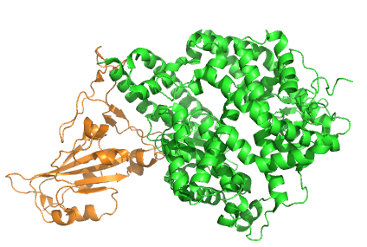
Intro_SARs-CoV-2
Target Protein: 6M0J
= SARS-CoV-2 spike receptor-binding domain bound with ACE2
ACE2 (from human enzyme)
Spike protein S1
6/29
Notes:
Unlike other PDB files, this protein file has 2 proteins which are docking each other. One is from virus, and the other is from human. In short, we can get drug effect data while those two proteins are interacting.

Slide 10
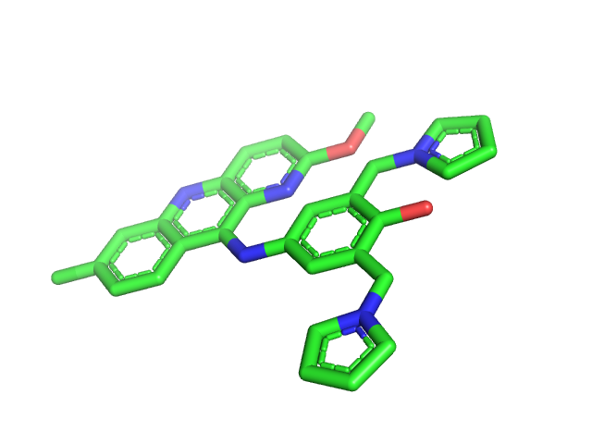
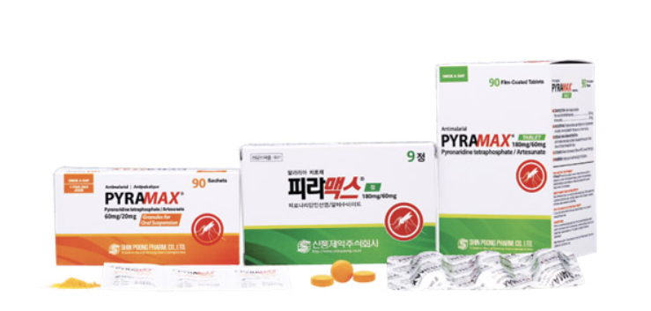
Intro_pyramax
Anti-malarial drug
Two substances
Artesunate:
Pyronaridine:
Studies that it inhibits the replication of SARS-CoV-2: An in vitro evaluation
“in vitro”: experiments refer to experiments conducted outside of a living organism, typically in a laboratory setting. (e.g. test tubes, petri dishes, or cell culture plates)
Notes:
Pyramax is an anti-malarial drug which consists of two substances. artesunate and pyronaridine. There are some studies that it inhibits the replication of SARS-CoV-2 “in vitro” condition.

Slide 11
Intro: remind
Artesunate
Pyronaridine
Docking simulation With Computational method (“in silico”) :
Find 1) Optimal binding sites 2) Optimal angle of each atom
Notes:
With computational method, we are going to simulate the drug-enzyme docking by finding optimal binding sites and optimal angle of each atom.

Slide 12
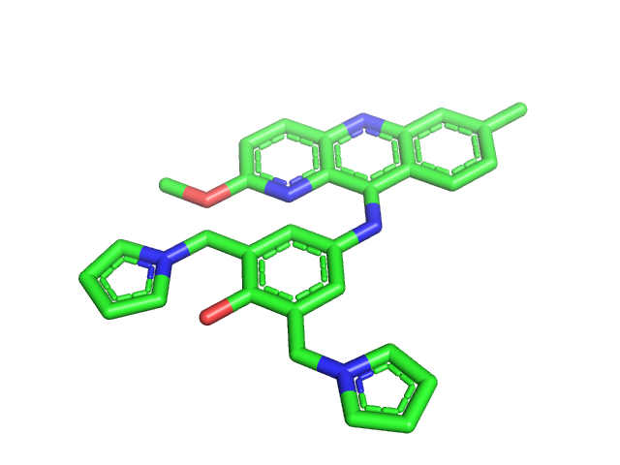
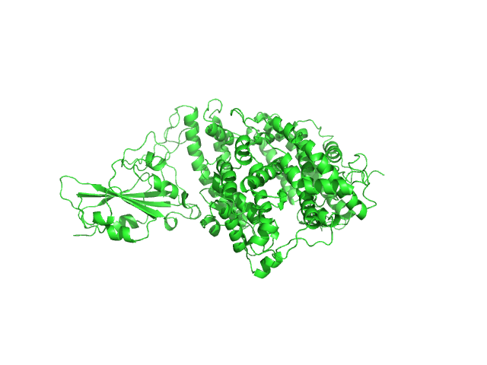
Goal & Workflow
Analyze the stability of the drug-protein complex
Virus amino-acid sequence
Virus protein
Drug / Ligand
Protein-Ligand Complex
>FASTA seq
STIEEQAKTFLDKFNHEAEDLFYQSSLASWNYNTN…..
Notes:
The goal is analyzing the stability of the drug-protein complex. The degree of stability of complex determine the possibility of drug against virus.

Slide 13
Goal & Workflow
Analyze the stability of the drug-protein complex
Virus amino-acid sequence
Virus protein
Drug / Ligand
Protein-Ligand Complex
>FASTA seq
STIEEQAKTFLDKFNHEAEDLFYQSSLASWNYNTN…..
PDB file
(3D form)
Notes:
This is the workflow. First, convert FASTA file to pdb file which contains 3D data such as coordinate values, folding information.

Slide 14
Goal & Workflow
Analyze the stability of the drug-protein complex
Virus amino-acid sequence
Virus protein
Drug / Ligand
Protein-Ligand Complex
>FASTA seq
STIEEQAKTFLDKFNHEAEDLFYQSSLASWNYNTN…..
PDB file
(3D form)
PDB file
(3D form)
Notes:
And the ligand pdb file is also needed.

Slide 15
Goal & Workflow
Analyze the stability of the drug-protein complex
Virus amino-acid sequence
Virus protein
Drug / Ligand
Protein-Ligand Complex
>FASTA seq
STIEEQAKTFLDKFNHEAEDLFYQSSLASWNYNTN…..
PDB file
(3D form)
PDB file
(3D form)
PDB file
(3D form)
Notes:
Lastly, conduct enzyme-ligand docking, then find binding site, and extract structural data.

Slide 16
Workflow: computational methods
(1) Alphafold2
Predict protein structure
(2) fPocket
Find possible
Binding-sites
(3) AutoDock
Protein-Ligand docking
(4) GROMACS
MD-simulation analyze stability
(5) Pymol
Visualization
Notes:
To do so, 5 computational methods are used.

Slide 17
Workflow_1/5: alphafold2
Predict the protein structure: Alphafold2 Colab
Alphafold2 Colab
Virus protein
Virus amino-acid sequence
>FASTA seq
STIEEQAKTFLDKFNHEAEDLFYQSSLASWNYNTN…..
Prediction
PDB file format
(3D data form)
Notes:
First, predict the protein structure using alphafold.
Alphafold2 is one method to predict protein folding structure.
It converts amino-acid sequence files to pdb file.

Slide 18
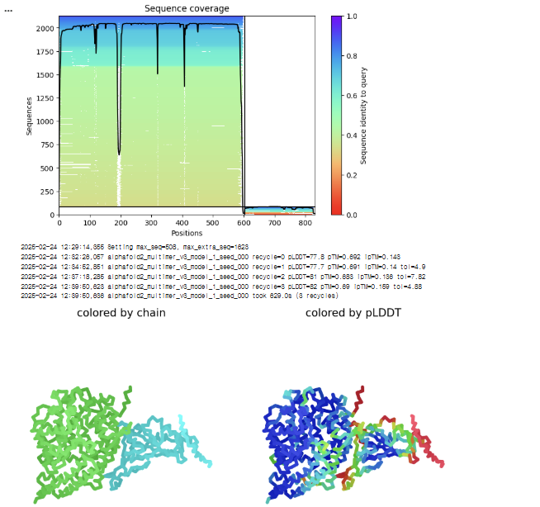
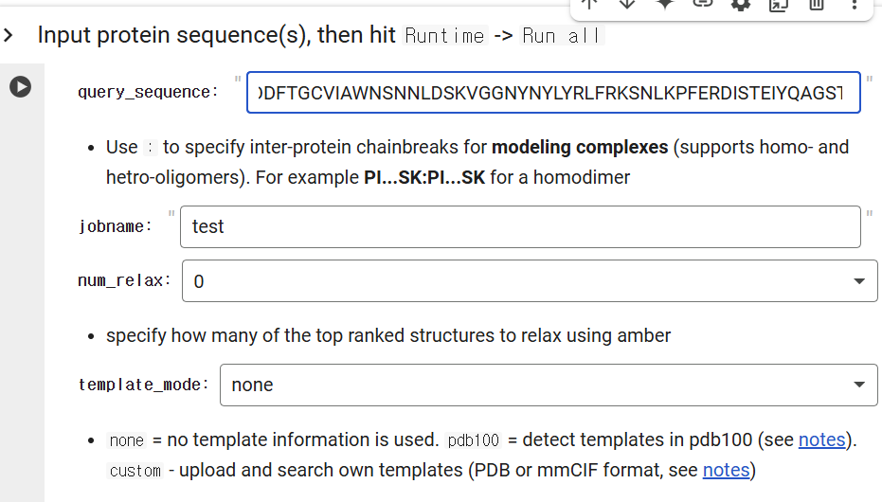
Workflow_1/5: alphafold2_example
Notes:
This is the image of Alphafold2 colab working.

Slide 19
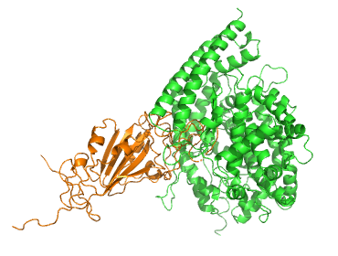
Workflow_1: alphafold2_example
6M0J
Real
Prediction
Differences in ACE2 and spike protein both.
Notes:
Since 6M0J consist of 2 proteins, there are some limitations in prediction. However, alphafold2 can predict more precise in monomers and mutated amino-acid sequence. Since there are some big differences from real data, we will use real data for further steps.

Slide 20
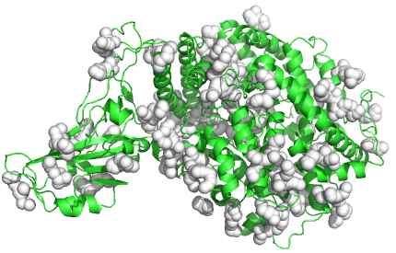
Workflow_2/5: fpocket
Find possible Binding-sites
Identify all possible binding sites of the ligand on the protein → Determine the box-size & the coordinate of the center
*box-size: size of the search space where the docking simulation will take place
*center coordinate: the central point (X, Y, Z) of the docking box
Notes:
After get 3D data file of protein, finding binding sites is needed.
fPocket Identify all possible binding sites of the ligand on the protein.

Slide 21
Workflow
Virus amino-acid sequence
Virus protein
Drug / Ligand
Protein-Ligand Complex
>FASTA seq
STIEEQAKTFLDKFNHEAEDLFYQSSLASWNYNTN…..

Slide 22
Workflow_3/5: Autodock
Protein-Ligand docking
AutoDock
Virus amino-acid sequence
Virus protein
Drug / Ligand
Protein-Ligand Complex
>FASTA seq
STIEEQAKTFLDKFNHEAEDLFYQSSLASWNYNTN…..
Notes:
Now, conduct protein-ligand complex using AutoDock

Slide 23
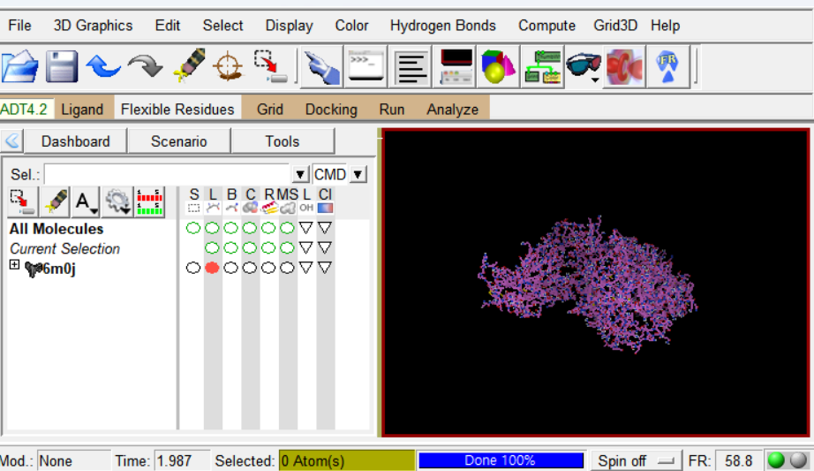
Workflow_3/5: Autodock
Enzyme pdb file
Ligand pdb file
Box-size
Center coordinate
AutoDock
1) Ligand coordinate
2) Binding affinity
Convert pdb files to pdbqt files
Delete water
Add hydrogen
Setting Gasteiger Charges
17/29
Notes:
There are four inputs.
Convert pdb files to pdbqt files.
Then, obtain ligand coordinate data and binding affinity data.

Slide 24
What is binding affinity?
Strength of the interaction between ligand & protein
= How tightly a ligand binds to its target protein
Binding Affinity (ΔG, kcal/mol) | Interpretation & Drug-Like Potential
0 ~ -4 kcal/mol | Very weak binding, likely non-specific, low drug potential
-4 ~ -6 kcal/mol | Moderate binding, may require optimization
-6 ~ -8 kcal/mol | Good binding, potential drug candidate
-8 ~ -10 kcal/mol | Strong binding, likely biologically active
< -10 kcal/mol | Very strong binding, promising drug lead
18/29
Notes:
Binding affinity refers to the strength of the interaction between a ligand (e.g., drug) and a target molecule (e.g., protein or receptor). It quantifies how tightly a ligand binds to its target protein. Binding affinity is often expressed in terms of binding free energy (ΔG, in kcal/mol)
Lower ΔG values indicate stronger binding (more favorable interaction)

Slide 25
Autodock_Result: binding affinity
Protein-Ligand complex
6M0J – Pyronaridine complex
6M0J – Artesunate complex
Mode | Affinity (kcal/mol) | Distance from best mode
 |  | rmsd l.b. | rmsd.u.b.
1 | -8.5 | 0.000 | 0.000
2 | -8.3 | 7.604 | 11.323
3 | -8.2 | 13.188 | 17.018
4 | -7.9 | 11.411 | 15.485
5 | -7.7 | 11.480 | 14.379
6 | -7.7 | 8.741 | 11.509
7 | -7.6 | 18.123 | 21.860
8 | -7.5 | 11.566 | 14.748
9 | -7.4 | 17.874 | 20.679
10 | -7.3 | 9.062 | 12.455
Mode | Affinity (kcal/mol) | Distance from best mode
 |  | rmsd l.b. | rmsd.u.b.
1 | -8.9 | 0.000 | 0.000
2 | -8.9 | 49.102 | 51.150
3 | -8.7 | 51.335 | 54.075
4 | -8.7 | 48.503 | 50.696
5 | -8.7 | 30.876 | 35.489
6 | -8.5 | 35.073 | 38.653
7 | -8.4 | 37.343 | 38.791
8 | -8.2 | 49.522 | 53.559
9 | -8.2 | 52.393 | 54.650
10 | -8.0 | 30.085 | 34.596
Notes:
RMSD l.b. (Lower Bound) : Measures the minimum possible deviation between the docked pose and the reference pose RMSD u.b. (Upper Bound) : Measures the maximum possible deviation, considering both flexible and rigid parts
There are 10 modes on each ligand, which means there are 10 different locations for each ligand.

Slide 26
Autodock_Result: binding affinity
Protein-Ligand complex
6M0J – Pyronaridine complex
6M0J – Artesunate complex
Mode | Affinity (kcal/mol) | Distance from best mode
 |  | rmsd l.b. | rmsd.u.b.
1 | -8.5 | 0.000 | 0.000
2 | -8.3 | 7.604 | 11.323
3 | -8.2 | 13.188 | 17.018
4 | -7.9 | 11.411 | 15.485
5 | -7.7 | 11.480 | 14.379
6 | -7.7 | 8.741 | 11.509
7 | -7.6 | 18.123 | 21.860
8 | -7.5 | 11.566 | 14.748
9 | -7.4 | 17.874 | 20.679
10 | -7.3 | 9.062 | 12.455
Mode | Affinity (kcal/mol) | Distance from best mode
 |  | rmsd l.b. | rmsd.u.b.
1 | -8.9 | 0.000 | 0.000
2 | -8.9 | 49.102 | 51.150
3 | -8.7 | 51.335 | 54.075
4 | -8.7 | 48.503 | 50.696
5 | -8.7 | 30.876 | 35.489
6 | -8.5 | 35.073 | 38.653
7 | -8.4 | 37.343 | 38.791
8 | -8.2 | 49.522 | 53.559
9 | -8.2 | 52.393 | 54.650
10 | -8.0 | 30.085 | 34.596
Notes:
Choose mode that has the lowest value of affinity, which means the best mode.

Slide 27
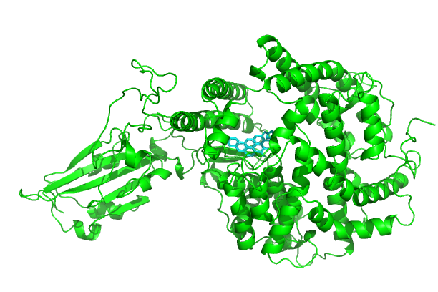
Autodock: pyronaridine model 1
20/29

Slide 28
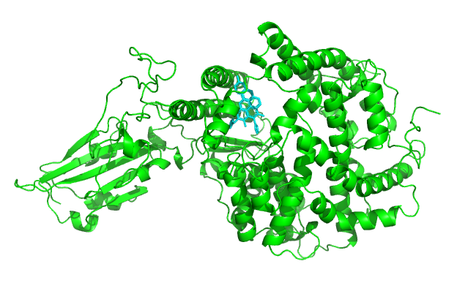
Autodock: pyronaridine model 2
20/29

Slide 29

Autodock: pyronaridine model 3
20/29

Slide 30
Workflow_4/5: gromacs (Md-simulation)
Research on after docking.
Protein-Ligand Complex
GROMACS
Predict
Stable structural data
AutoDock
Optimal angle, distance,..
20/29
Notes:
We can research structural changes or molecular interaction after docking by using MD-simulation.
Gromacs is the one method of MD-simulation, it can be used to predict stable structural form. It means, it predict the final structure, final interactions.

Slide 31
Workflow_4/5: gromacs (Md-simulation)
MD-Simulation : Molecular Dynamic Simulation A computational technique that models the physical movements of atoms and molecules over time.
Key Components: 1. Force Fields: Mathematical models that define how atoms interact (e.g., AMBER, CHARMM). 2. Integration Algorithms: Used to calculate changes in position and velocity over time 3. Simulation Box: Defines the boundary conditions for molecular systems
Notes:
MD-simulation is A computational technique that models the physical movements of atoms and molecules over time.
It is useful to predict the interactions, and structural changes after docking. There are 3 key components in MD-simulation.

Slide 32
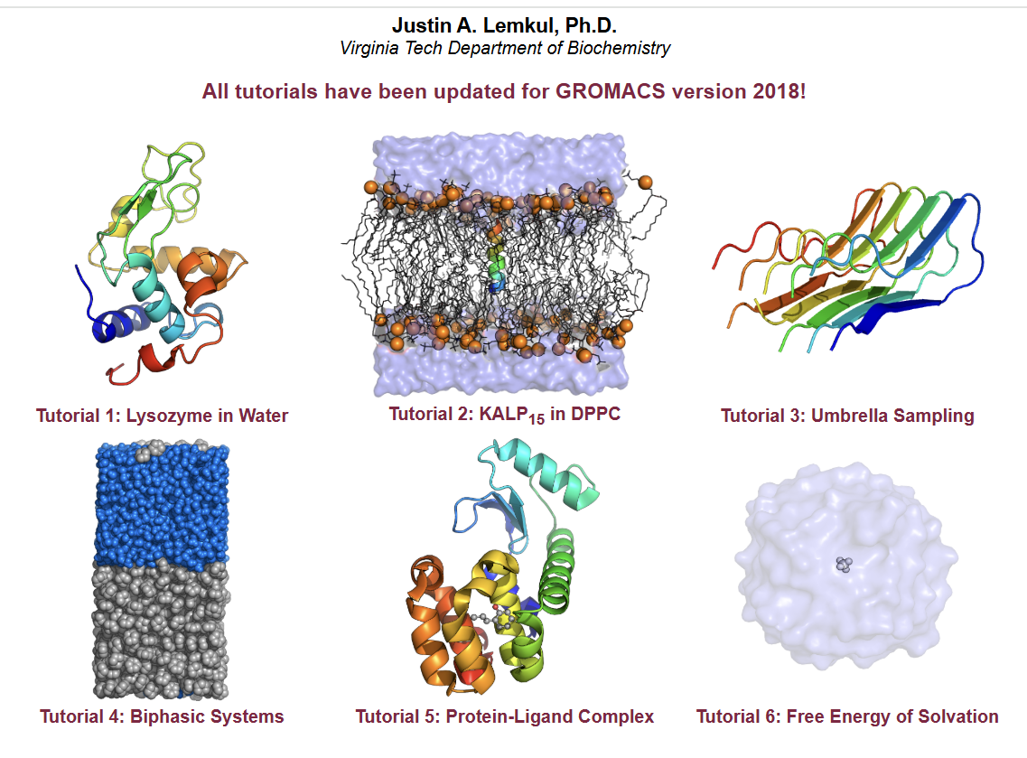
Workflow_4/5: gromacs (components)

Slide 33
Workflow_4/5: gromacs (components)
Notes:
3 key components are based on GROMACS homepage tutorials and other journals.

Slide 34
Workflow_4/5: gromacs (components)
At 310 K, 1 atm
Component |  | Configuration
Force field | Protein | AMBER14SB
 | Ligand | GAFF
Integration Algorithm |  | Velocity Verlet integrator
Simulation Box |  | -d 1.0 -bt dodecahedron
Create a dodecahedral box, maintaining a minimum gap of 1.0 nm from the box border to the protein.
Notes:
These are The hyperparameters that I chose. In NVE/NPT simulation conditions, it exhibits better energy conservation.
(constant in number of molecules, volume, energy
constant in number of molecules, pressure, temperature)
Create a dodecahedral box, maintaining a minimum gap of 1.0 nm from the box border to the protein for simulation environment.

Slide 35
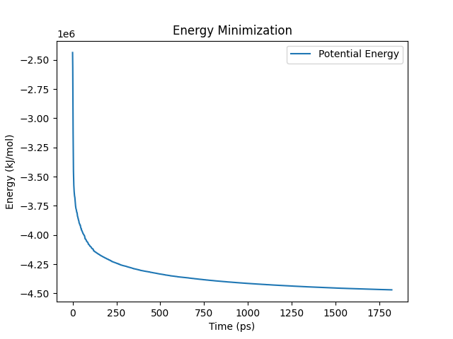
Gromacs_Energy Minimization
Process of minimizing the potential energy of a system to increase structural stability
→ Finding
Optimal distance
Optimal angle between each atom
Condition: 310 K, 1 atm
→ Predicting 1) the lowest energy structure 2) physically stable structure
Notes:
This is the one result of GROMACS simulation. Gromacs energy minimization is the Process of minimizing the potential energy of a system to increase structural stability.
This process is useful to find optimal structure to increase stability.

Slide 36
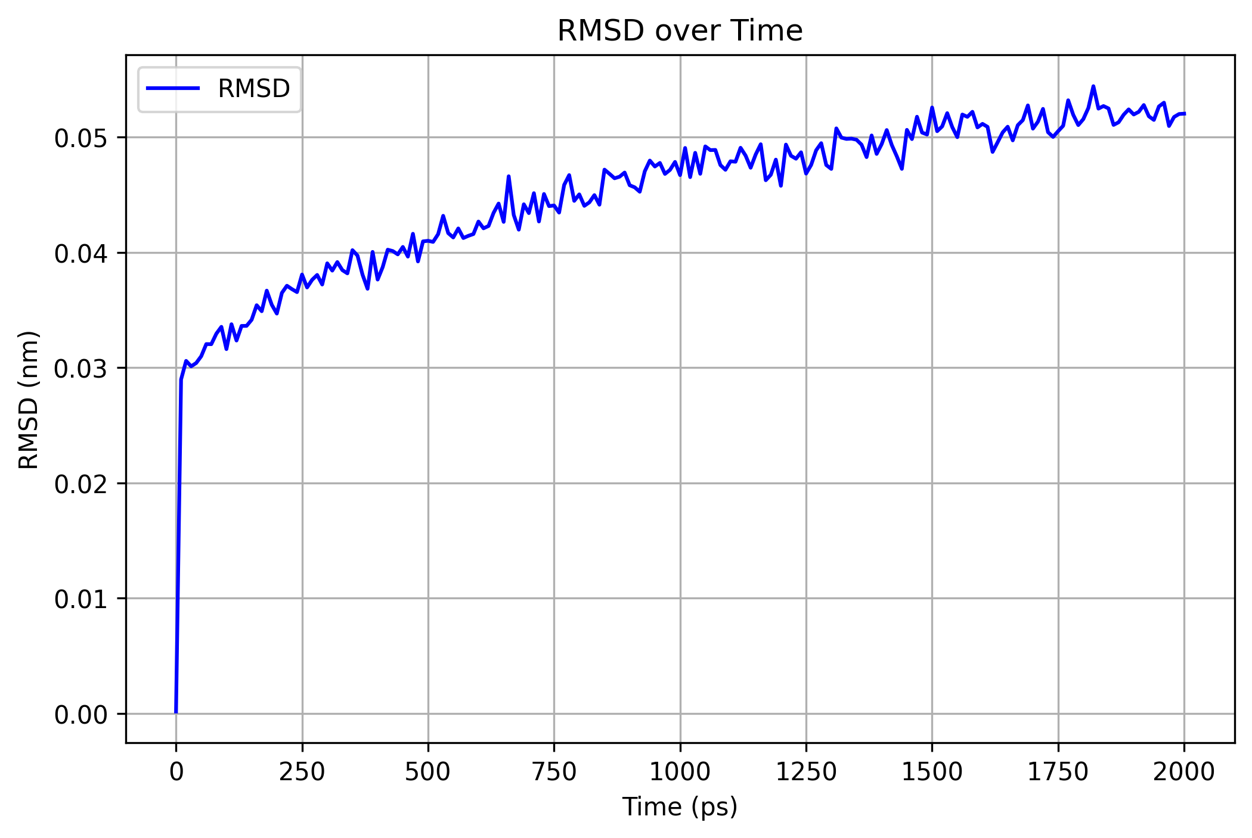
Analyze_RMSD
RMSD = Root Mean Square Deviation
Compared with the initial value
After docking
Initial state: Dramatically increased
Stabilization state: stable value: 0.05nm ~ 0.06nm
= remains stable without significant structural deformation
Notes:
RMSD is the Root Mean Square Deviation compared with the initial value.
As the value get almost constant, it means that the structure become stable.

Slide 37
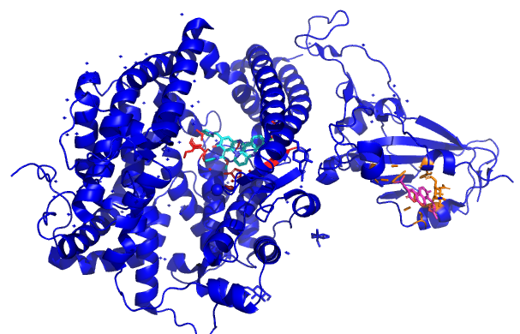
Workflow 5/5: pymol visualization
Pyronaridine (mint color)
Artesunate (pink color)
Notes:
This is the result of visualization. This is the end of my project.

Slide 38
Further analysis
PHE 40 PHE 40 ASP 206 ASP 206 ASP 206 ASP 206 ALA 348 ASP 350 ASP 350 ASP 350 ASP 350 ASP 350 ASP 350 ASP 350 ASP 350 GLY 352 HIS 378
……….
Notes:
For further analysis, we can extract the binding site amino-acid sequence. Study on where mutations occur or making new drug structure.

Slide 39
Workflow
Virus amino-acid sequence
Virus protein
Drug / Ligand
Protein-Ligand Complex
STIEEQAKTFLDKFNHEAEDLFYQSSLASWNYNTN…..

Slide 40
Thank you
Notes:
Thank you for listening .

Slide 41
Q&A
Q&A
29/29
Notes:
If you have any questions feel free to ask

Slide 42
REFERENCE
Trott, O., & Olson, A. J. (2009). AutoDock Vina: Improving the speed and accuracy of docking with a new scoring function, efficient optimization, and multithreading. Journal of Computational Chemistry, 31(2), 455–461. https://doi.org/10.1002/jcc.21334
Gendrot, M., Andreani, J., Boxberger, M., Jardot, P., Fonta, I., Bideau, M. L., Duflot, I., Mosnier, J., Rolland, C., Bogreau, H., Hutter, S., La Scola, B., & Pradines, B. (2020). Antimalarial drugs inhibit the replication of SARS-CoV-2: An in vitro evaluation. Travel Medicine and Infectious Disease, 37, 101873. https://doi.org/10.1016/j.tmaid.2020.101873
Brás, N.F., Cerqueira, N.M.F.S.A., Sousa, S.F., Fernandes, P.A., Ramos, M.J. (2014). Protein Ligand Docking in Drug Discovery . In: Náray-Szabó, G. (eds) Protein Modelling. Springer, Cham. https://doi.org/10.1007/978-3-319-09976-7_11
Konc, J., Lešnik, S. & Janežič, D. Modeling enzyme-ligand binding in drug discovery. J Cheminform 7, 48 (2015). https://doi.org/10.1186/s13321-015-0096-0
Bae, J., Lee, G. E., Park, H., Cho, J., Kim, Y., Lee, J., Ju, C., Kim, W., Kim, J. I., & Park, M. (2020). Pyronaridine and artesunate are potential antiviral drugs against COVID-19 and influenza. bioRxiv (Cold Spring Harbor Laboratory). https://doi.org/10.1101/2020.07.28.225102
Shukla, R., Tripathi, T. (2020). Molecular Dynamics Simulation of Protein and Protein–Ligand Complexes. In: Singh, D.B. (eds) Computer- Aided Drug Design. Springer, Singapore. https://doi.org/10.1007/978-981-15-6815-2_7
Google Colab. (n.d.). https://colab.research.google.com/github/sokrypton/ColabFold/blob/main/AlphaFold2.ipynb
RCSB PDB: Homepage. (n.d.). https://www.rcsb.org/
National Center for Biotechnology Information. (n.d.). PubChem. National Library of Medicine. Retrieved February 14, 2025, from https://pubchem.ncbi.nlm.nih.gov/

